Slide 1

New York City - Segmentation On
Basis Of NightLife
Sahil Sanwal

Slide 2
Methodology
Data Sources
NYU Spatial Data Repository I am using the ‘2014 New York City Neighbourhood Names’ dataset hosted by NYU’s Spatial Data Repository as the basis for the neighbourhood names and associated location centroids [0].
The image to the right shows a sample of this information:
Foursquare ‘Places API’
I will be using Foursquare’s ‘Places API’ to acquire data related to ‘venues’ (as defined by Foursquare) categorized to be somehow associated with music [1]. It is important to note that Foursquare defines a ‘venue’ as a place that one can go to, or checkin to, and that a ‘venue’ is not necessarily a music venue but can be any establishment such as a restaurant or type of retail shop. Each Foursquare ‘venue’ is assigned a ‘category’ and each ‘category’ is associated with a particular ‘categoryID’. The image to the right shows the ‘categoryID’ values provided by Foursquare that will be used to acquire music related venues within New York City:
Data Retrieval
Neighborhood Name & Location Centroid Data
The ‘2014 New York City Neighborhood Names’ dataset hosted by NYU’s Spatial Data Repository was easy to download as a JSON file and import into a Jupyter Notebook
The ‘Borough’, ‘Neighborhood’, ‘Latitude’, and ‘Longitude’ values associated with each neighborhood were then converted from JSON to a Pandas DataFrame that serves as the foundation of the analysis.

Slide 3
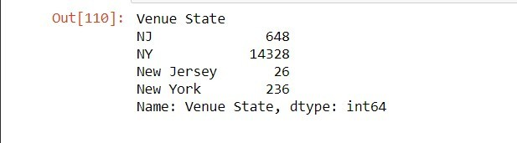
Foursquare Nightlife Related Venue Data
As mentioned in the Data Sources section of this report, Foursquare has numerous ‘Venue Categories’ that are used to identify each type of venue. A ‘get’ request to the ‘api.foursquare.com/v2/venues/search?’ endpoint that provides a category ID will return venues of that category
Exploratory Data Analysis
Exploratory data analysis was done to answer multiple questions regarding nighlife, the questions and findings are mentioned below-
Q-What states are venues located in ?
A-Refer to image below, following are states and number of venues
Q-How many categories are there that are unique for nightlife
A-There are 104 unique categories
Data Preprocessing
Data cleaning
The preliminary dataset was cleaned according to the answers listed in the Exploratory Data Analysis section above. First, venues located in states other than “New York” or “NY” were removed. Entries with “Venue State” equal to “New York” were changed to “NY.”
Entries returned by Foursquare with no ‘Venue City’ and given the ‘N/A’ treatment were also removed:
A list of nightlife related venue categories was created based on the unique venue categories included in the preliminary dataset. This list was used to filter out the non nighlife related entries that snuck into our request

Slide 4
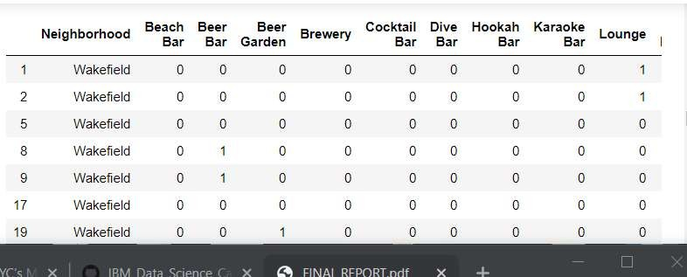
One Hot Encoding Venue Categories
In order to use Foursquare’s category values to find similar neighborhoods based on music venues, a onehotencoding representation of each entry was created using Pandas’ ‘get_dummies’ function. The result was a dataframe of New York City musicrelated venues where entry venue category is represented by a value of 1 in the column of matching venue category, as shown below:

Slide 5
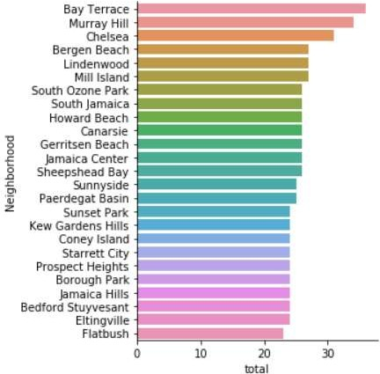
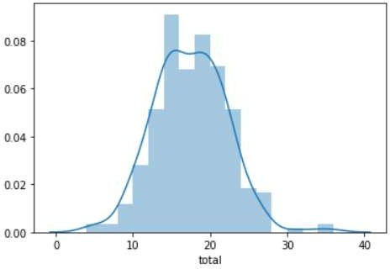
Data Visualization
Description of top 25 neighbourhoods nightlife
Description of density variations of nightlife in New York city

Slide 6
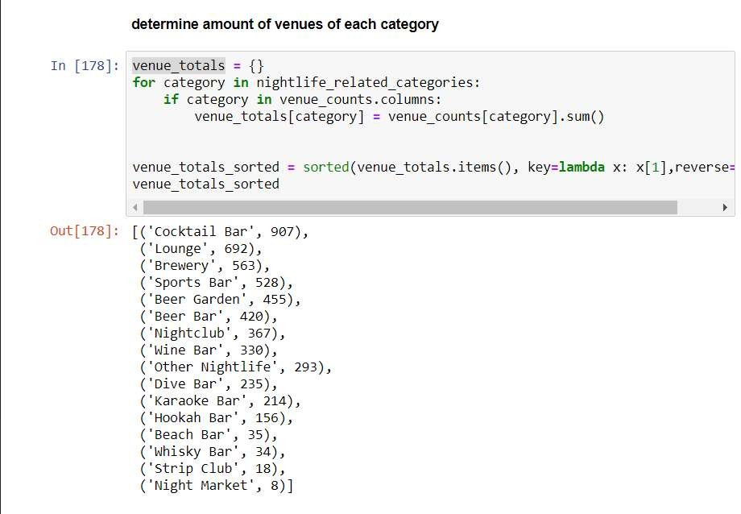
Feature Generation
The encoded dataset of nightlife related venues in New York City was then used to quantify a nightlife profile for each neighbourhood. For each venue category, the percent distribution of venues across each neighbourhood was calculated. This information would then be used to fit a K- Means clustering algorithm to the data in an effort to determine neighbourhoods of similar nighlife venue profile
Finally, the percentage of venues in each neighbourhood was calculated with respect to the total amount of venues in the dataset, by venue category

Slide 7
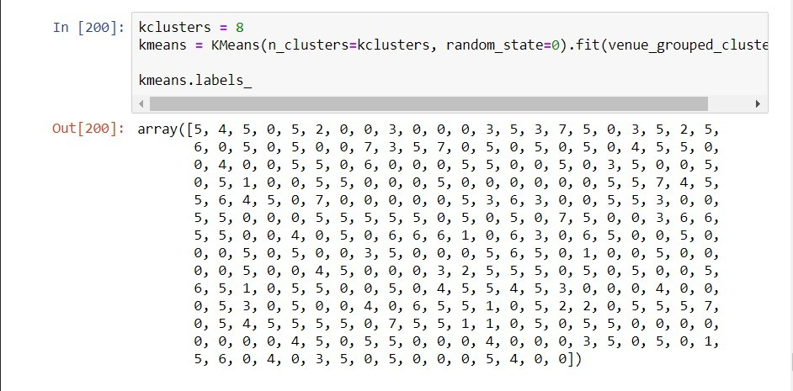
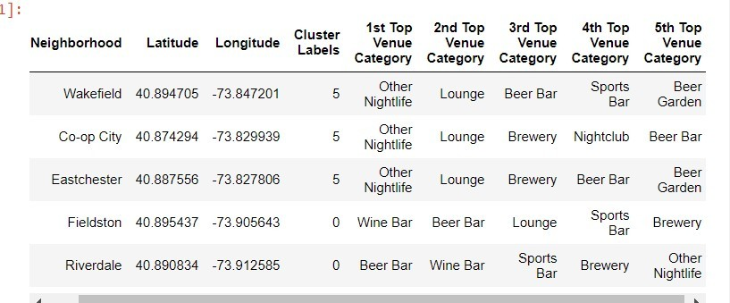
Results
Cluster Modelling
Scikitlearn’s KMeans clustering was used to determine similar neighborhoods based on music venue percentage. The image below shows the data being scaled and the KMeans model being created:
A new dataframe was created by merging neighborhood location data with cluster labels and top venue categories.

Slide 8
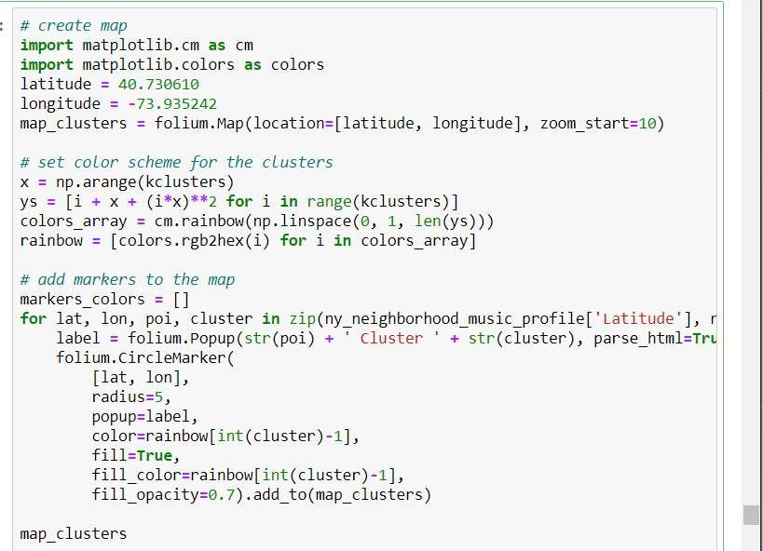
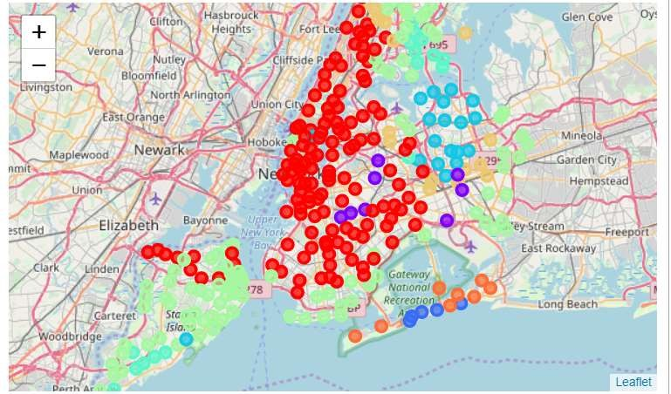
Cluster Visualization:
The following code uses folium to visualize neighborhoods of similar nightlife profile by coloring each neighborhood point based on cluster label:

Slide 9
Conclusion
Machine learning and clustering algorithms can be applied to multidimensional datasets to find similarities and patterns in the data. Clusters of neighborhoods of similar nightlife profile, or any profile, can be generated using highquality venue location data. There is a preface on highquality because analysis models are only as good as the input into them (garbage in, garbage out). Luckily, Foursquare offers a robust ‘Places API’ service that, although (as we have seen) not perfect (nothing is), can be leverages in similar studies and modelmaking. This project could be expanded on in a number of different ways.
Foursquare’s API could be further interrogated to retrieve and consider more musicrelated
venues in New York City. New datasets of nightlife related venues can be acquired and potentially merged with what was retrieved from Foursquare. The DBSCAN clustering algorithm, better at maintaining dense clusters and ignoring outliers, could be implemented and compared to KMeans. The clustering model could become the basis for a recommendation system aimed to provide neighborhoods of similar music profile to users.

